Slide 1
Search Problems
Data Analytics with R Machine Learning: Introduction, Supervised Learning, Unsupervised Learning, Collaborative Filtering, Social Media Analytics, Mobile Analytics, Big Data Analytics with BigR

Slide 2
Search Problems
Data Analytics
Definition: Data Analytics refers to the techniques and processes used to examine large and varied datasets to uncover hidden patterns, correlations, trends, and insights—especially to help in decision-making and strategic planning.
Key Components:
Data Collection
Data Cleaning
Data Exploration and Analysis
Data Visualization
Decision-Making

Slide 3
Search Problems
Machine Learning
Definition: Machine Learning is a field of computer science that gives systems the ability to automatically learn and improve from experience without being explicitly programmed. It involves building mathematical models based on sample data—known as "training data"—to make predictions or decisions.

Slide 4
Search Problems
Features of ML
Feature | Description | Example
Learning from Data | Models improve automatically by analyzing and learning from input data. | Spam filters learn from labeled emails to detect new spam.
Automated Decision-Making | Makes predictions or decisions without human intervention once trained. | YouTube recommends videos based on watch history.
Adaptability | Adjusts to new data or environmental changes, improving performance over time. | Weather forecasting models adapt to changing patterns.
Scalability | Handles large datasets and high-dimensional data efficiently. | Google search handles billions of queries using ML algorithms.
Versatility | Applicable across various fields and data types (text, image, audio, etc.). | ML is used in finance, healthcare, agriculture, and marketing.
Improvement Over Time | Performance increases as more training data becomes available. | Voice assistants like Siri get better with user interactions.
Model Evaluation & Feedback | Uses evaluation metrics to validate models and refine them with feedback. | Accuracy, precision, and recall are used to evaluate classification models.
Real-Time Predictions | Provides instant results using streaming or live data. | Credit card fraud detection works in real-time.
Feature Engineering | Focuses on identifying and using the most relevant input variables (features). | 'Income' and 'age' used to predict loan approval.

Slide 5
Search Problems
Need for ML
Reason | Explanation | Example
Big Data Processing | Handles huge volumes of structured and unstructured data. | Analyzing millions of user reviews.
Automation | Performs tasks without manual programming. | Email spam filtering, product recommendations.
High Accuracy | Improves over time with more data and better algorithms. | Disease diagnosis using medical images.
Adaptability | Adjusts to changing patterns or new inputs. | Weather forecasting with updated data.
Solving Complex Tasks | Solves tasks that are hard for rule-based systems. | Facial recognition, speech-to-text systems.
Real-Time Predictions | Delivers instant results based on live data. | Fraud detection in banking transactions.

Slide 6
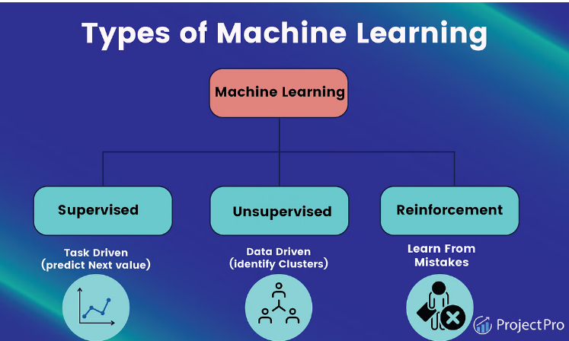
Search Problems
Types of ML
https://www.projectpro.io/article/types-of-machine-learning/623

Slide 7
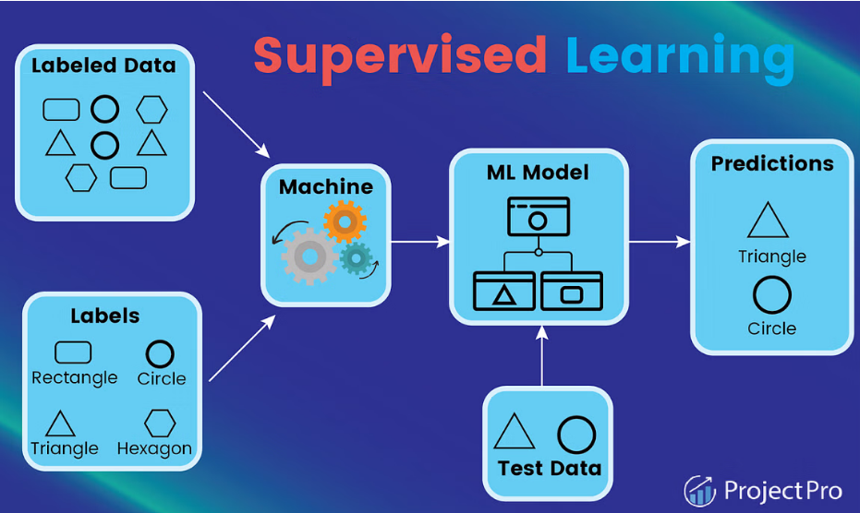
Search Problems
Supervised Learning
https://www.projectpro.io/article/types-of-machine-learning/623

Slide 8
Search Problems
Categories of Supervised Learning
Classification
Predicts the label of a class
Predict the dataset's categories
Example: "Yes" or "No"
Commonly Used Algorithms:
Decision Tree Algorithm
Logistic Regression
Random Forest Algorithm
Support Vector Machine Algorithm

Slide 9
Search Problems
Categories of Supervised Learning
Regression:
Predicts the numerical label/continuous variables
Example: weather prediction
Commonly used algorithms:
Simple Linear Regression Algorithm
Logistic Regression

Slide 10
Search Problems
Supervised Learning Algorithms
Algorithm | Description | Use Cases/ Applications
Linear Regression | Predicts continuous output using a linear relationship. | Price prediction, sales forecasting
Logistic Regression | Binary classification using logistic function. | Spam detection, disease diagnosis
Decision Trees | Tree-based model for classification and regression. | Customer churn, credit scoring
Random Forest | Ensemble of decision trees to improve accuracy. | Fraud detection, image classification
Support Vector Machines | Finds the best boundary to separate classes. | Text classification, face recognition
K-Nearest Neighbors (KNN) | Classifies based on nearest neighbors. | Recommendation systems, handwriting recognition
Naive Bayes | Probabilistic classifier assuming feature independence. | Email spam filtering, sentiment analysis
Gradient Boosting Machines | Ensemble boosting technique for better performance. | Ranking, classification tasks
Neural Networks | Models complex patterns inspired by the brain. | Image/speech recognition

Slide 11
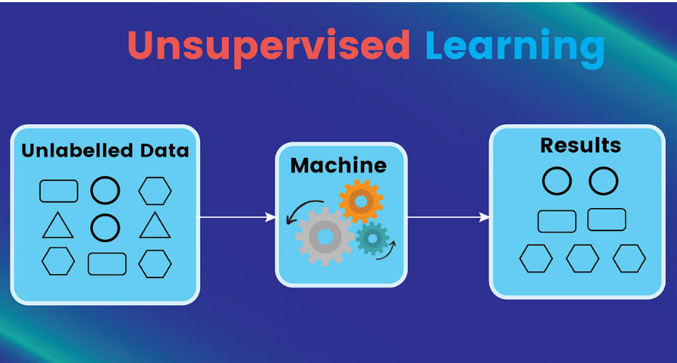
Search Problems
Unsupervised Learning
https://www.projectpro.io/article/types-of-machine-learning/623

Slide 12
Search Problems
Categories of Unsupervised Learning
Association
Finds relations between variables in a large dataset
Goal: discover and map data dependent on the other to produce maximum profit
Example: web usage mining
Commonly used algorithms:
Apriori algorithm
FP-growth algorithm

Slide 13
Search Problems
Categories of Unsupervised Learning
Clustering
A method of grouping each set of similar objects into a cluster
Goal: discover inherent groups from the dataset
Example: retail marketing
Commonly used algorithms:
K-Means Clustering Algorithm
DBSCAN Algorithm
Principal Component Analysis

Slide 14
Search Problems
Unsupervised Learning Algorithms
Algorithm | Description | Use Cases/ Applications
K-Means Clustering | Groups data into k clusters by minimizing variance. | Customer segmentation, image compression
Hierarchical Clustering | Builds a tree of clusters by merging/splitting based on distance. | Document clustering, gene analysis
DBSCAN | Density-based clustering to find arbitrary clusters and outliers. | Anomaly detection, geospatial analysis
Principal Component Analysis (PCA) | Reduces dimensionality by creating uncorrelated components. | Data visualization, noise reduction
Autoencoders | Neural networks for feature learning and dimensionality reduction. | Image denoising, anomaly detection
Apriori Algorithm | Finds frequent itemsets and association rules. | Market basket analysis

Slide 15
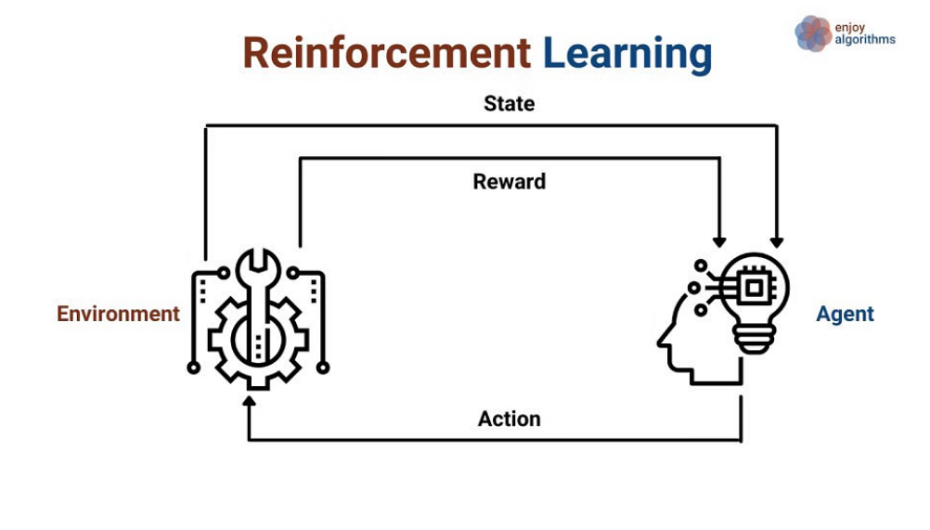
Search Problems
Reinforcement Learning
https://www.projectpro.io/article/types-of-machine-learning/623

Slide 16
Search Problems
Categories of Unsupervised Learning
Positive Reinforcement Learning
Negative Reinforcement Learning

Slide 17
Search Problems
Applications
Robotics
Video Games
Self driving Automobiles

Slide 18
Search Problems
Recommendation Systems
A Recommendation System is an algorithm that provides personalized suggestions to users by analyzing data such as user behavior, item features, or both.
Two types
Collaborative Filtering – It recommends items based on similarity measures between users and/or items. The basic assumption behind the algorithm is that users with similar interests have common preferences.
Content-Based Filtering - It is supervised machine learning used to induce a classifier to discriminate between interesting and uninteresting items for the user

Slide 19
Search Problems
Collaborative Filtering
Collaborative Filtering is a recommendation technique that predicts what a user might like based on the preferences or behavior of many users. It uses historical user-item interaction data like ratings, clicks, or purchases.
It assumes that if users agreed in the past, they will agree in the future
No need for item metadata or explicit feature information — purely relies on user interactions

Slide 20
Search Problems
How does it works?
Collaborative Filtering builds a user-item matrix (ratings or interactions), where:
Rows = users
Columns = items
Values = user ratings or implicit feedback (e.g., clicks, purchases)
Based on this matrix, CF tries to estimate missing values to recommend items a user might like.

Slide 21
Search Problems
Types
Type | Description
User-Based CF | Finds users similar to the target user (using similarity metrics like cosine similarity, Pearson correlation) and recommends items those users liked.
Item-Based CF | Finds items similar to those liked by the user, then recommends those similar items.

Slide 22
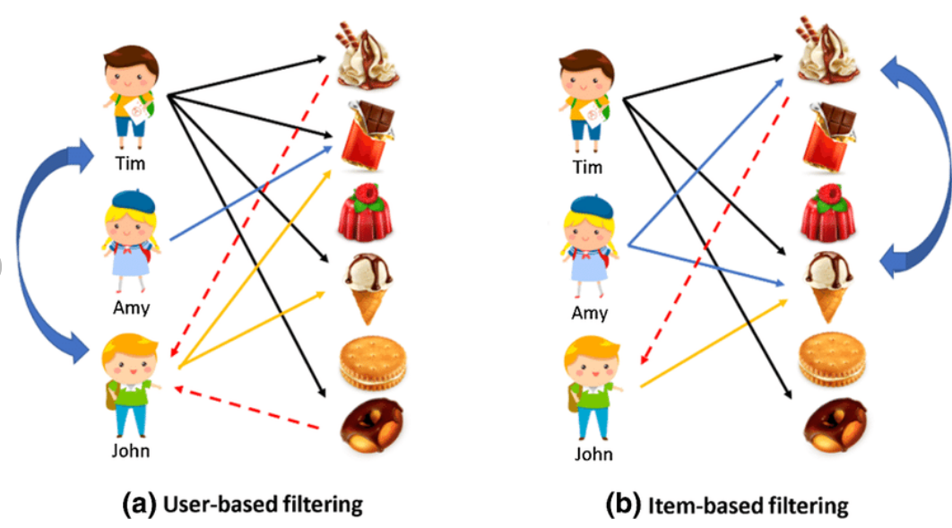
Search Problems
Types
https://www.researchgate.net/figure/Concepts-of-user-based-and-item-based-filtering_fig1_340361119

Slide 23
Search Problems
Similarity Measures
To find similar users or items, common similarity metrics are used:
Cosine Similarity: Measures the cosine of the angle between two vectors.
Pearson Correlation: Measures linear correlation between vectors.
Jaccard Similarity: Measures overlap between sets (used for binary data).

Slide 24
Search Problems
Steps in Collaborative Filtering
Build the user-item interaction matrix.
Compute similarity: between users or between items.
Find neighbors: Identify top-k similar users/items.
Predict ratings: For items the user hasn’t rated by aggregating neighbors’ ratings.
Generate recommendations: Suggest items with highest predicted ratings.

Slide 25
Search Problems
Challenges
Challenge | Explanation
Cold Start Problem | Difficulty recommending for new users or new items without interaction data.
Data Sparsity | User-item matrix is usually sparse, making similarity calculations less reliable.
Scalability | Computing similarities for millions of users/items is resource-intensive.
Synonymy Problem | Different items that mean the same thing may not be recognized as similar.
Gray Sheep Users | Users whose tastes differ greatly from all others are hard to recommend for.

Slide 26
Search Problems
Applications
Movie Recommendations: Netflix, Hulu recommend movies based on user viewing habits.
E-commerce: Amazon recommends products based on purchase history of similar users.
Music Streaming: Spotify recommends songs or playlists based on listening habits.
Social Networks: Friend suggestions based on mutual connections and similar interests.

Slide 27
Search Problems
Social Media Analytics

Slide 28
Search Problems
Definition
Process of collecting, analyzing, and interpreting data from social media platforms.
Helps understand brand performance, audience behavior, and campaign effectiveness.
Goals of Social Media Analytics
Brand Monitoring: Track mentions, sentiment, and reach
Customer Engagement: Analyze likes, shares, comments
Campaign Analysis: Evaluate marketing success
Competitor Analysis: Compare with other brands
Trend Detection: Identify emerging hashtags and topics

Slide 29
Search Problems
What data is analyzed?
Engagement: Likes, shares, comments
Reach: Followers, impressions
Content: Post type, hashtags, time of post
Audience: Demographics, interests
Sentiment: Positive, neutral, negative feedback

Slide 30
Search Problems
Importance
Improve productivity of your organization
To analyse potential competition
To enhance customer reach:
Improve product quality
Strategic decision-making
Sentiment analysis

Slide 31
Search Problems
Types of Social Media Analytics
Performance analysis/metrics:
Key performance metrics includes:
interactions across platforms and over time to determine if the posted content is properly engaging the audience;
whether the number of followers is increasing over time to verify consistent progress across platforms; and
click-through rate for link clicks on posts to see if they're properly driving traffic from social media channels.
The metrics includes-
Impressions, Reach, Likes, Comments, Shares, Views, ClicksSales

Slide 32
Search Problems
Types of Social Media Analytics
Audience analytics
It's important to clearly understand and define the target audience, as it is the most important element of a social media strategy. Understanding the audience will help create a favorable customer experience with content targeted at what customers want and what they're looking for.
The metrics includes-
Age, Gender, Devices, and Location

Slide 33
Search Problems
Types of Social Media Analytics
Competitor analysis
With social media analytics tools, social media performance can be compared to competitors' performance with a head-to-head analysis to gauge relative effectiveness and to determine what can be improved.
Paid social analytics
Ad spending is serious business. If targeting and content isn't right, it can end up an expensive proposition for unsuccessful content. More advanced analytics tools can often predict which content is most likely to perform well and be a less risky investment for a marketing budget.
The measures includes:
Total number of active ads, Clicks, Click-through rate, Cost-per-click, Cost-per-engagement, Cost-per-action, Conversion rate, Total ad spend

Slide 34
Search Problems
Types of Social Media Analytics
Influencer analysis
Sentiment analysis

Slide 35
Search Problems
Techniques Used in Social Media Analytics
Technique | Description
Natural Language Processing (NLP) | For sentiment analysis and keyword extraction
Text Mining | Discover patterns or insights from textual posts
Machine Learning | Classify topics, predict trends
Hashtag/Trend Analysis | Identify popular or viral topics
Network Analysis | Understand social interactions and influence

Slide 36
Search Problems
Tools for Social Media Analytics
Tool | Features
Hootsuite | Scheduling, monitoring, basic analytics
Sprout Social | In-depth analytics, competitor tracking
BuzzSumo | Content discovery, influencer analytics
Google Analytics | Tracks traffic from social media
Brandwatch | Advanced sentiment and audience insights
R / Python | Custom analytics using machine learning models

Slide 37
Search Problems
Applications
Industry | Use Case
Marketing | Understand consumer response to campaigns
Politics | Analyze public opinion or election sentiment
Customer Service | Identify and respond to complaints faster
Journalism | Spot breaking news or trending issues
Retail/E-commerce | Track product mentions and improve engagement

Slide 38
Search Problems
Mobile Analytics

Slide 39
Search Problems
Definition
Mobile Analytics refers to the process of collecting, measuring, and analyzing data generated by users interacting with mobile applications or websites. It helps businesses understand user behavior, app performance, engagement metrics, and conversion patterns on mobile devices.
Goals of Mobile Analytics
Goal | Description
User Engagement | Track how users interact with the app
Performance Monitoring | Analyze load time, crashes, battery usage
Conversion Tracking | Understand user journeys and funnel drop-offs
Retention Improvement | Identify why users leave and how to retain them
Revenue Optimization | Analyze in-app purchases, ad clicks, and subscription data

Slide 40
Search Problems
Key Metrics in Mobile Analytics
Metric | Description
DAU / MAU | Daily/Monthly Active Users
Session Length | Time spent in a single app session
Retention Rate | Percentage of users returning after a period
Churn Rate | Rate at which users stop using the app
Conversion Rate | % of users who complete desired actions (e.g., purchase)
Crash Rate | Frequency of app crashes
Average Revenue per User (ARPU) | Revenue earned per user

Slide 41
Search Problems
How do mobile analytics work?
Mobile analytics typically track:
Page views
Visits
Visitors
Source data
Strings of actions
Location
Device information
Login / logout
Custom event data

Slide 42
Search Problems
How do mobile analytics work?
Companies use this data to figure out what users want in order to deliver a more satisfying user experience.
For example, they’re able to see:
What draws visitors to the mobile site or app
How long visitors typically stay
What features visitors interact with
Where visitors encounter problems
What factors are correlated with outcomes like
How different teams use mobile analytics:
Marketing: Tracks campaign ROI, segments users, automates marketing
UX/UI: Tracks behaviors, tests features, measures user experience
Product: Tracks usage, A/B test features, debugs, sets alerts
Technical teams: Track performance metrics such as app crashes

Slide 43
Search Problems
Applications
Industry | Use Case
E-commerce | Track product views, purchases, and checkout behavior
Gaming | Monitor level completions, in-game purchases
Education | Analyze course completion and engagement
Finance | Monitor login frequency, transaction completion
Healthcare | Track app usage, reminders, and user retention

Slide 44
Search Problems
Challenges in Mobile Analytics
Cross-Device Tracking: Users switching between devices,
Data Privacy Compliance: Handling GDPR, CCPA requirement
Offline Data Handling: Tracking actions done without internet
High Data Volume: Real-time processing at scale

Slide 45
Search Problems
Big Data Analytics

Slide 46
Search Problems
Introduction
Definition: Big Data Analytics is the process of examining large and varied datasets—called Big Data—to uncover hidden patterns, unknown correlations, market trends, customer preferences, and other useful business information.
The techniques includes:
Text Analytics
Memory Analytics
Statistical methods
Data Mining
Machine Leaning
Social Media Analytics
Predictive Analytics

Slide 47
Search Problems
Introduction
Definition: Big Data Analytics is the process of examining large and varied datasets—called Big Data—to uncover hidden patterns, unknown correlations, market trends, customer preferences, and other useful business information.
The techniques includes:
Text Analytics
Memory Analytics
Statistical methods
Data Mining
Machine Leaning
Social Media Analytics
Predictive Analytics

Slide 48
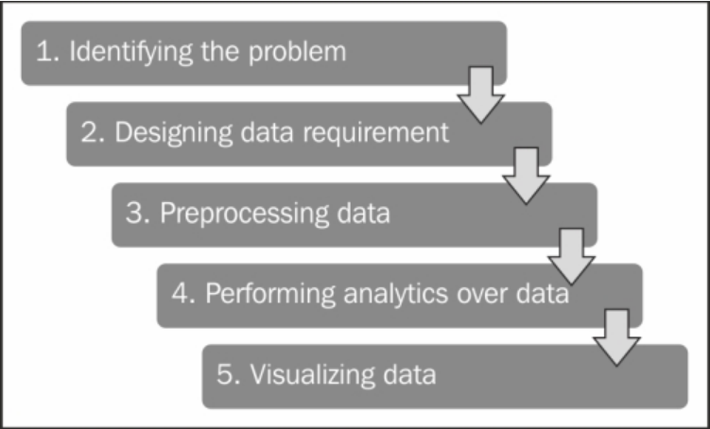
Search Problems
Big Data Analytics Life Cycle

Slide 49
Search Problems
Identifying the Problem: Identifies the key objective or problem to solve using analytics
Designing the data requirement/ Data Collection: Gather relevant data from various sources.
Sources: Web logs, social media, sensors, databases, transaction records.
Data Preprocessing/ Data Wrangling: Clean and prepare data for analysis
Steps: Removing or Handling missing values, Outliers removal
Performing Analytics over Data/ Data Analysis: Analyze data using various statistical and machine learning techniques
Types: Descriptive, Diagnostic, Predictive, Prescriptive
Data Visualization: Present data insights in an understandable format.
Techniques: Charts, Graphs, Dashboards

Slide 50
Search Problems
Why Use R for Big Data Analytics
Advantage | Explanation
Rich Statistical Capabilities | Built-in support for statistical modeling and machine learning
Data Visualization | Excellent plotting libraries like ggplot2, plotly
Open Source & Extensible | A large ecosystem of packages for data handling, modeling, and visualization
Interoperability | Interfaces with Hadoop, Spark, and databases (SQL, NoSQL)
Parallel & Distributed Computing | Supports parallel computing for big data processing

Slide 51
Search Problems
Key Tools and Packages for Big Data Analytics with R
Integration with Distributed Systems:
sparklyr:
Interface between R and Apache Spark.
Enables large-scale data processing and machine learning on distributed data.
Rhadoop:
Integrates R with Hadoop.
Includes packages like:
rhdfs: For interacting with Hadoop Distributed File System (HDFS)
rmr2: For writing MapReduce jobs in R.
plyrmr: For manipulating structured data on Hadoop.

Slide 52
Search Problems
2. Big Memory Management
bigmemory: Handles datasets larger than RAM by storing them in shared memory.
ff: Manages datasets too large for memory by storing them on disk.
3. Data Manipulation and Analysis
data.table: Optimized for fast manipulation of large datasets in R.
dplyr with Databases: Can work with SQL databases for large data.
4. Machine Learning
MLlib via Spark: Scalable machine learning using sparklyr.

Slide 53
Search Problems
Steps to Perform Big Data Analytics with Big R
1. Data Loading:
Use tools like rhdfs to load data from HDFS or connect to cloud data sources (e.g., AWS S3).
Load data into distributed memory frameworks like Spark using sparklyr.
2. Data Preprocessing:
Use dplyr or data.table for summarization. cleaning, transformation,
For distributed data, leverage Spark's in-built capabilities.
3. Exploratory Data Analysis (EDA):
Perform summary statistics and visualize and data using ggplot2 or plotly.
Use scalable methods to handle subsets or aggregated data.

Slide 54
Search Problems
Steps to Perform Big Data Analytics with Big R
4. Model Building:
For distributed machine learning:
Use Spark MLlib via sparklyr for linear regression, decision trees, clustering, etc.
For large local datasets: Use packages like biglm for linear models.
5. Result Visualization:
Use visualization libraries like ggplot2, shiny, or plotly to present findings.
6. Export and Deployment:
Save results to HDFS or a database for further use.
Deploy models using APIs or tools like R Shiny

